Slide 1
E-Commerce and Technologies
Social Networks, Auctions, and Portals

Slide 2
Objectives
Explain the difference between a traditional social network and an online social network.
Explain how a social network differs from a portal.
Describe the different types of social networks and online communities and their business models.
Describe the major types of auctions, their benefits and costs, and how they operate.
Explain when to use auctions in a business.
Recognize the potential for auction abuse and fraud.
Describe the major types of Internet portals.
Explain the business models of portals.

Slide 3
Social Networks and Online Communities
Internet began as community building technology for scientists, researchers
Early communities limited to bulletin boards, newsgroups; e.g., the Well
2002: mobile Internet devices, blogs, sharing of rich media began new era of social networking
Social networking one of most common Internet activities

Slide 4
What Is an Online Social Network?
Area online where people who share common ties can interact
Participants do not necessarily share goals
Portals and social networks:
Moving closer together
Portals adding social networking features
Community sites adding portal-like services
Searching
News
E-commerce services

Slide 5
The Growth of Social Networks and Online Communities
Top 10 social networks account for over 90% social networking activity
Facebook users: over 49% are 35+

Slide 6
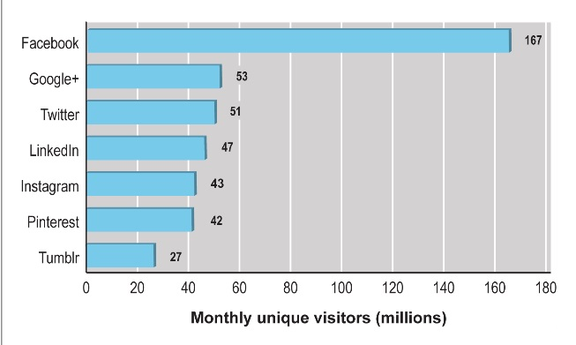
Top 10 Social Network Sites 2009 vs. 2008

Slide 7
Types of Social Networks and Their Business Models
Early networking sites relied on subscriptions
Today primarily advertising
General communities:
Offer opportunities to interact with general audience organized into general topics
Advertising supported by selling ad space on pages and videos
Practice networks:
Offer focused discussion groups, help, and knowledge related to area of shared practice
May be profit or non-profit; rely on advertising or user donations

Slide 8
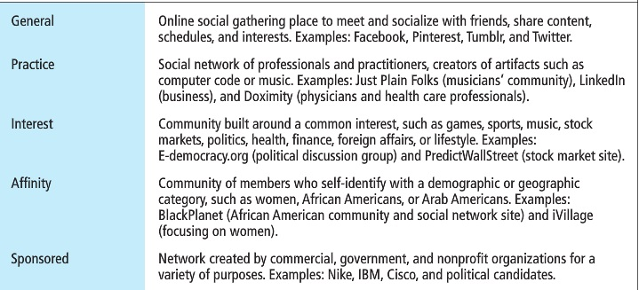
Types of Social Networks And Their Business Models

Slide 9
Social Network Features and Technologies
Profiles
Friends network
Network discovery
Favorites
E-mail
Storage
Instant messaging
Message boards
Online polling
Chat
Discussion groups
Experts online
Membership management tools

Slide 10
Online Auctions
Online auction sites among the most popular consumer-to-consumer sites on the Internet
eBay: market leader
Several hundred different auction sites in the United States alone
Established portals and online retail sites increasingly are adding auctions to their sites

Slide 11
Defining and Measuring the Growth of Auctions and Dynamic Pricing
Dynamic pricing
Airline tickets, coupons, college scholarships
Prices based on demand characteristics of customer and supply situation of seller
Many types of dynamic pricing
Bundling
Trigger pricing
Utilization pricing
Personalization pricing

Slide 12
Defining and Measuring the Growth of Auctions and Dynamic Pricing
Auctions: type of dynamic pricing
C2C auctions
Auction house an intermediary
B2C auctions
Business owns assets; often used for excess goods
Can be used to allocate, bundle resources

Slide 13
Benefits of Auctions
Liquidity
Price discovery
Price transparency
Market efficiency
Lower transaction costs
Consumer aggregation
Network effects
Market maker benefits: no inventory or fulfillment activities

Slide 14
Risks and Costs of Auctions for Consumers and Businesses
Delayed consumption costs
Monitoring costs
Possible solutions include:
Fixed pricing
Watch lists
Proxy bidding
Equipment costs
Trust risks
Possible solution—rating systems
Fulfillment costs

Slide 15
Internet Auction Basics
Different from traditional auctions
Last much longer (usually a week)
Variable number of bidders who come and go from auction arena
Market power and bias in dynamically priced markets
Neutral: number of buyers and sellers is few or equal
Seller bias: few sellers and many buyers
Buyer bias: many sellers and few buyers

Slide 16
Internet Auction Basics
Price allocation rules
Uniform pricing rule: multiple winners who all pay the same price
Discriminatory pricing rule: winners pay different amount depending on what they bid
Public vs. private information
Prices bid may be kept secret
Bid rigging
Open markets
Price matching

Slide 17
Types of Auctions
English auctions:
Single item up for sale to single seller
Highest bidder wins
Traditional Dutch auction:
Uses a clock that displays starting price
Clock ticks down price until buyer stops it
Dutch Internet auction:
Public ascending price, multiple units
Final price is lowest successful bid, which sets price for all higher bidders

Slide 18
Types of Auctions
Name your own price auctions
Users specify what they are willing to pay for goods or services and multiple providers bid for their business
Prices do not descend and are fixed
Group buying auctions (demand aggregators)
Group buying of products at dynamically adjusted discount prices based on high volume purchases
Two principles
Sellers more likely to offer discounts to buyers purchasing in volume
Buyers increase their purchases as prices fall

Slide 19
Types of Auctions
Professional service auctions
Example: Elance.com
Auction aggregators (mega auctions)
Use Web crawlers to search thousands of Web auction sites and accumulate information on products, bids, auction duration, etc.
Unlicensed aggregators opposed by eBay

Slide 20
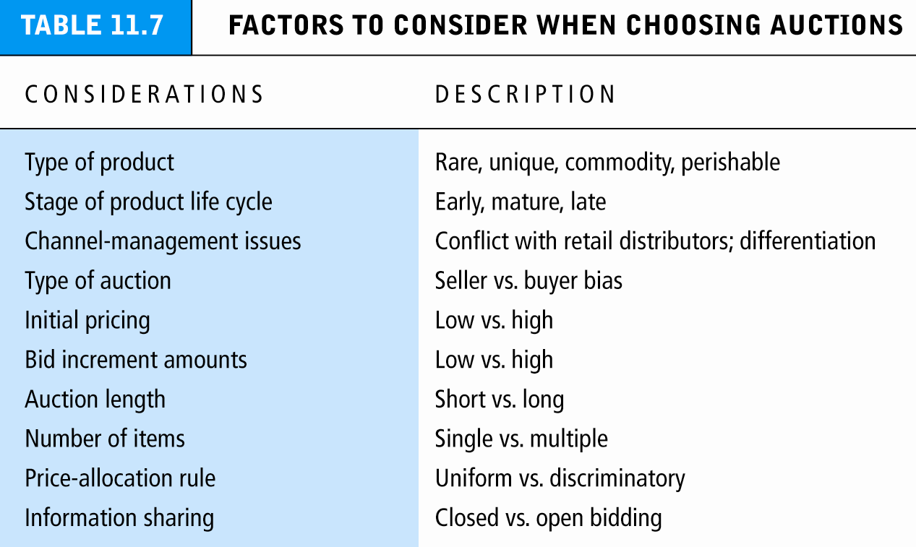

Slide 21
Seller and Consumer Behavior at Auctions
Seller profit: arrival rate, auction length, and number of units at auction
Auction prices not necessarily the lowest
Unintended results of participating in auctions:
Winner’s regret
Seller’s lament
Loser’s lament
Consumer trust an important motivating factor in auctions

Slide 22
When Auction Markets Fail: Fraud and Abuse in Auctions
Markets fail to produce socially desirable outcomes in four situations:
Information asymmetry, monopoly power, public goods, and externalities.
Auction markets prone to fraud
Most common: failure to deliver, failure to pay
In 2009, 25% of Internet fraud complaints concern online auctions

Slide 23
Portals
Most frequently visited sites on Web
Original portals were search engines
As search sites, attracted huge audiences
Today provide:
Navigation of the Web
Commerce
Content (own and others’)
Compete on reach and unique visitors
Enterprise portals
Help employees find important organizational content

Slide 24
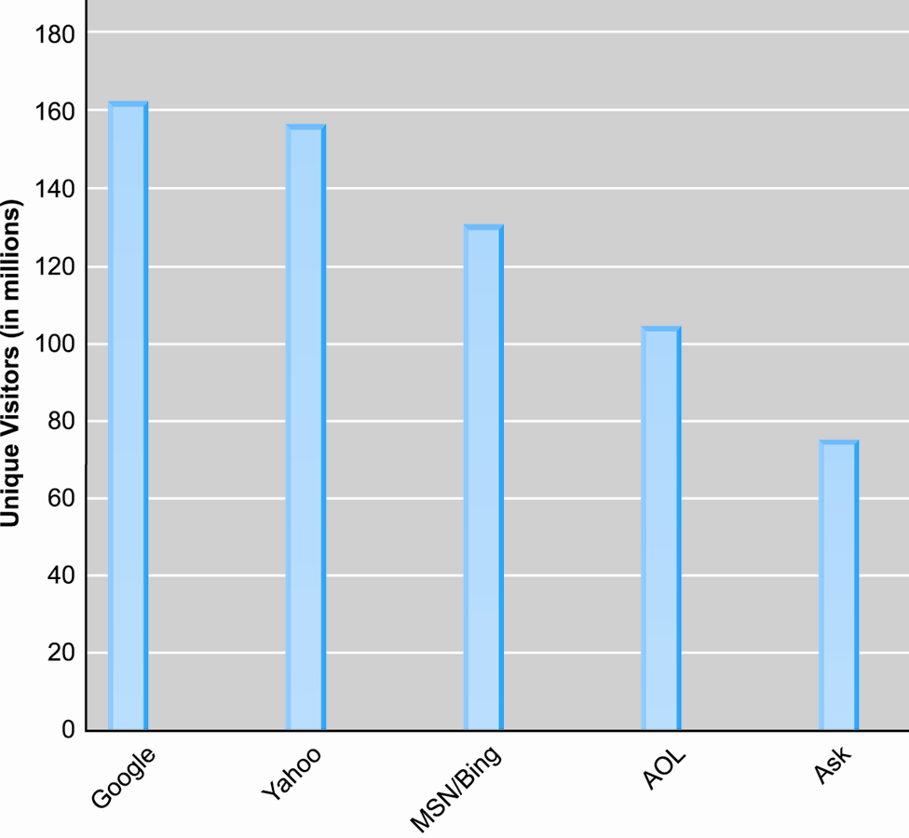
Top 5 Portal/Search Engines in the United States

Slide 25
Types of Portals
General purpose portals:
Attempt to attract very large general audience
Retain audience by providing in-depth vertical content channels
E.g., Yahoo, MSN
Vertical market portals:
Attempt to attract highly focused, loyal audiences with specific interest in:
Community (affinity group); e.g., iVillage.com
Focused content; e.g., ESPN.com

Slide 26
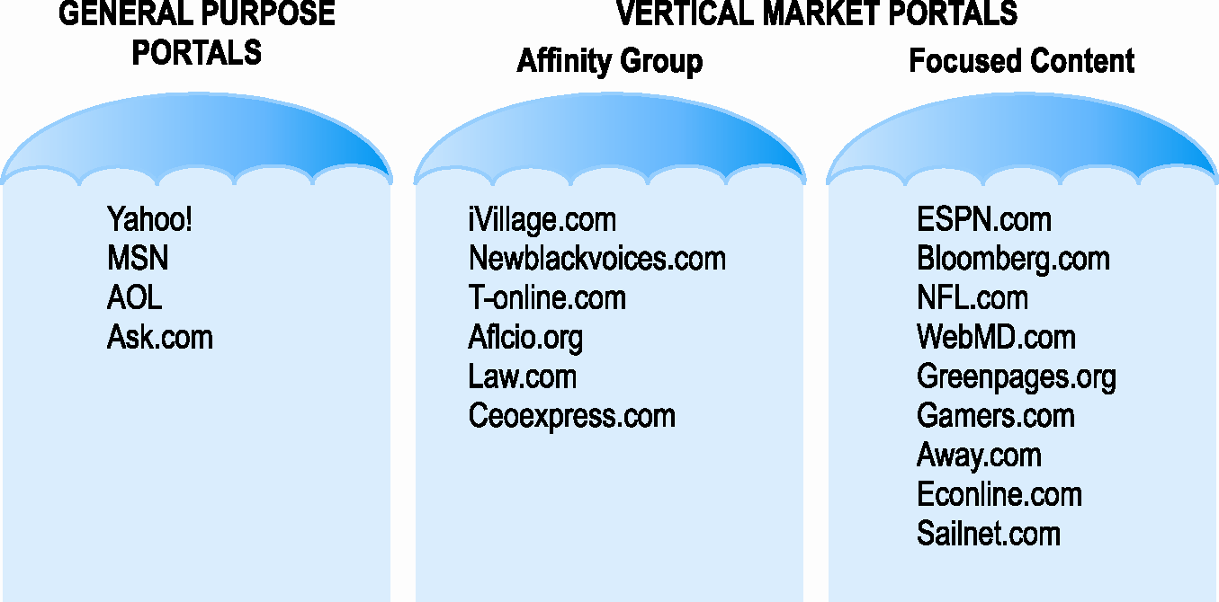
Two General Types of Portals: General Purpose and Vertical Market Portals

Slide 27
Portal Business Models
ISP services
Provide Web access, e-mail for monthly fee
General advertising revenue
Charge for impressions delivered
Tenancy deals
Fixed charge for number of impressions, exclusive partnerships, “sole providers”
Commissions on sales
Sales at site by independent providers
Subscription fees
Charging for premium content

